Slide 1

Cooper Nederhood, Liqiang Yu, Laurence Warner

Slide 2
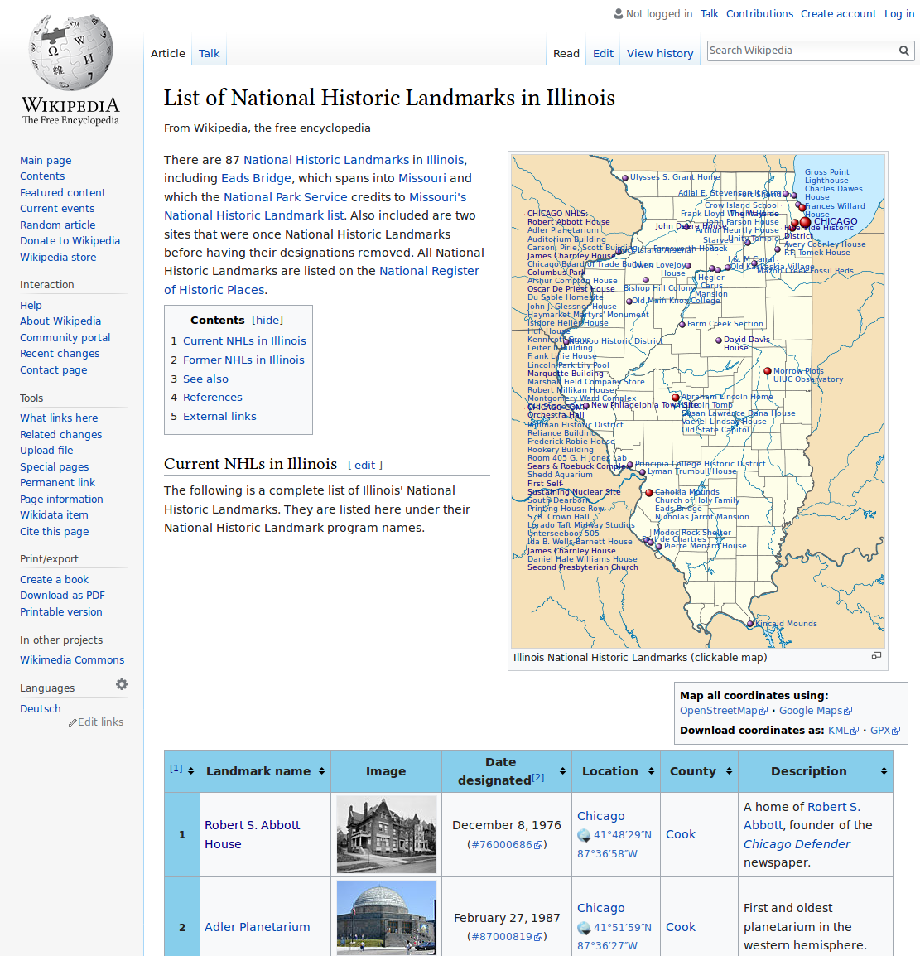
List of National Landmarks
87 in Illinois
Webscrape from wikipedia table
Scaleable - every state has such a page

Slide 3
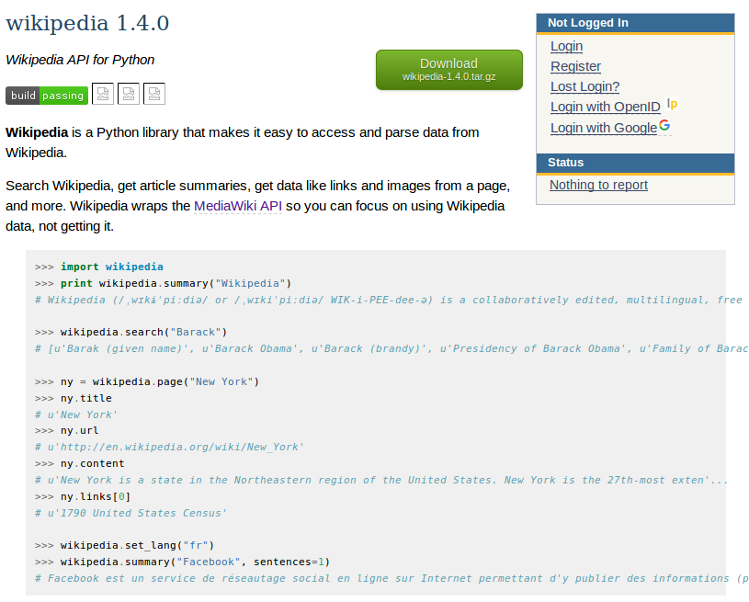
Wikipedia API
Wikipedia discourages scraping
API fetches wiki URL, summary, and full text
Easy to use for basic info

Slide 4

Selenium
Modern web automation
Interact with HTML similar to BeautifulSoup
Advanced interactions using ActionKeys

Slide 5
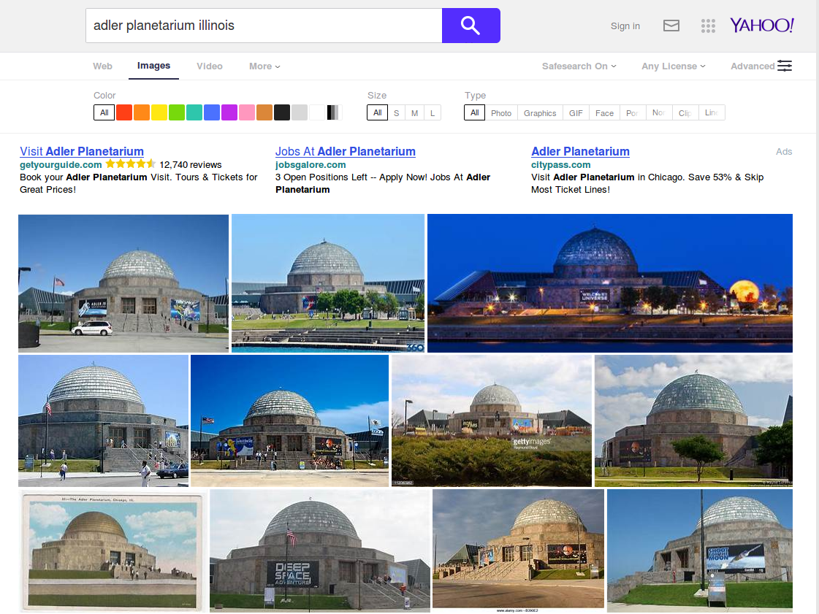
Selenium: Start FireFox, images search, ‘Click’

Slide 6
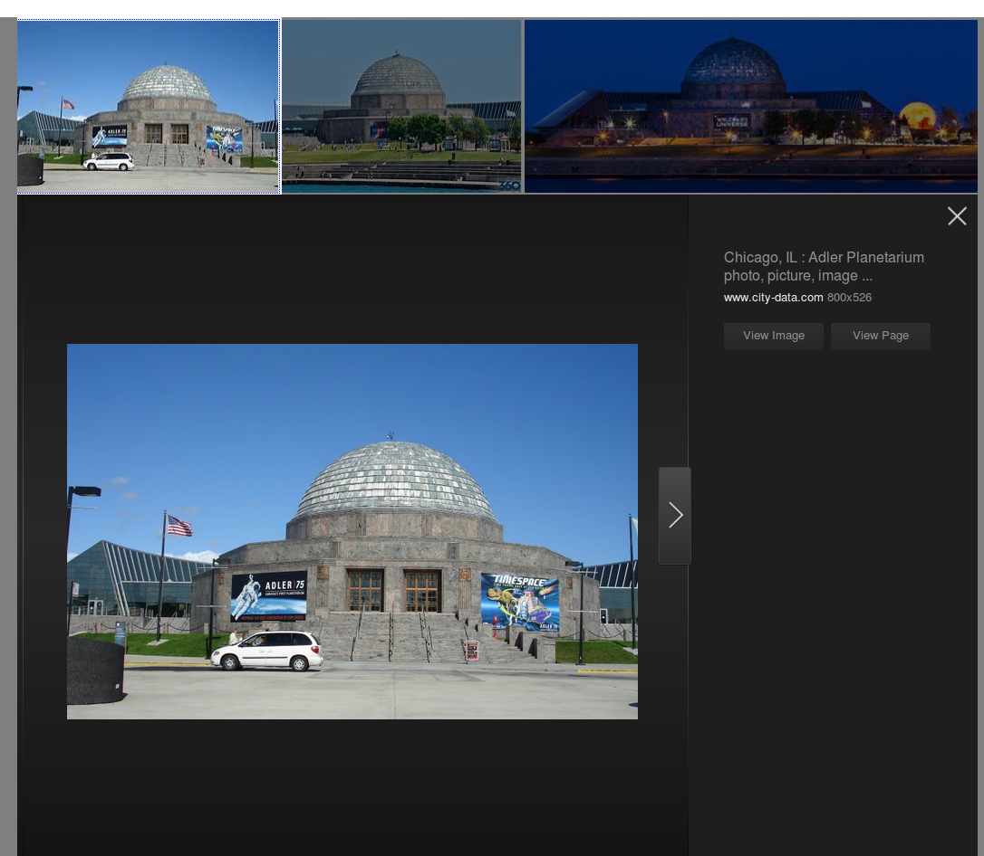
Selenium: Find “View Image”, SHIFT + ‘Click’

Slide 7
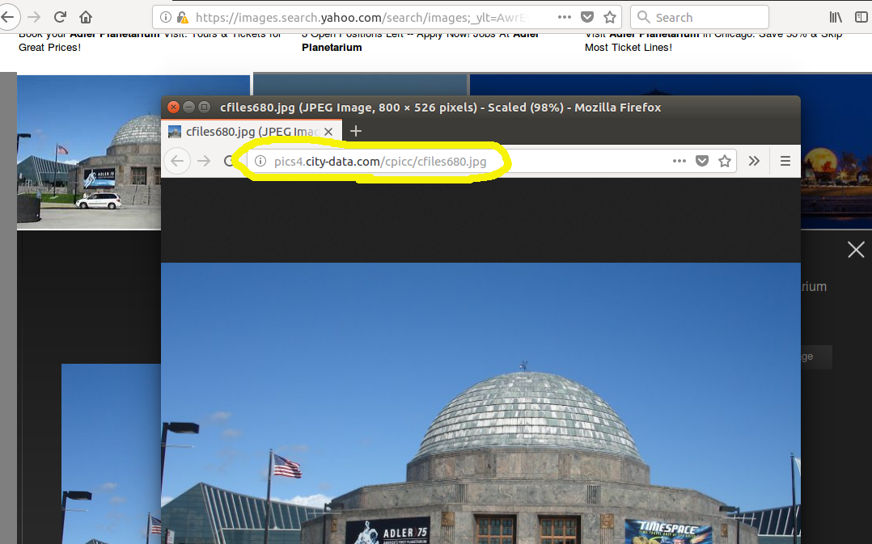
Selenium: Change window, save “.jpg”, close

Slide 8
Selenium: Close window, change control

Slide 9
Selenium: Go back and continue

Slide 10
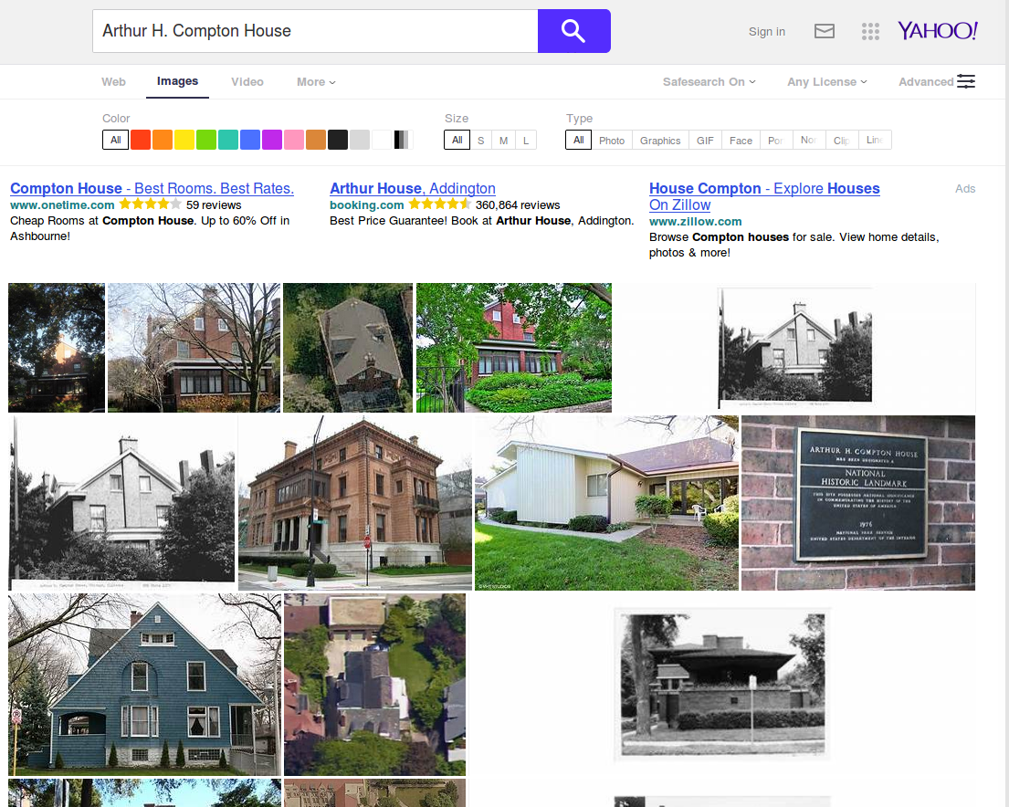
Insuring representative images
Bad machine learning algorithm?
Or unsuccessful image scrape?
Or bad source data?
Record summary stats of success rate

Slide 11
Bad data: Arthur H. Compton House (9%)

Slide 12
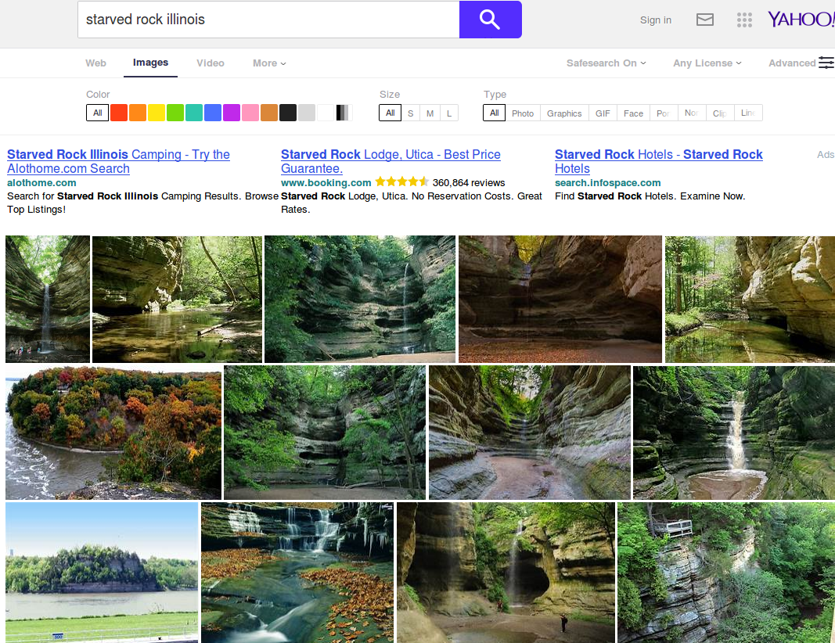
Good data: Starved Rock (93%)

Slide 13
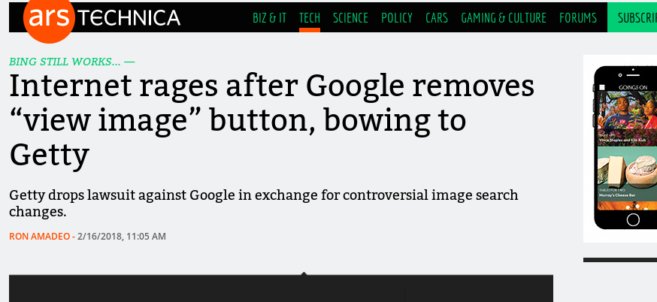
Why Yahoo?
Google Images vs Getty Images
Google loses
Removes “View Image” button to discourage unauthorized use of photos….

Slide 14
Image Classification---
A transfer learning
approach
Limited dataset size (~25 per leabel)
Limited computational resource (weeks on GPU clusters)

Slide 15
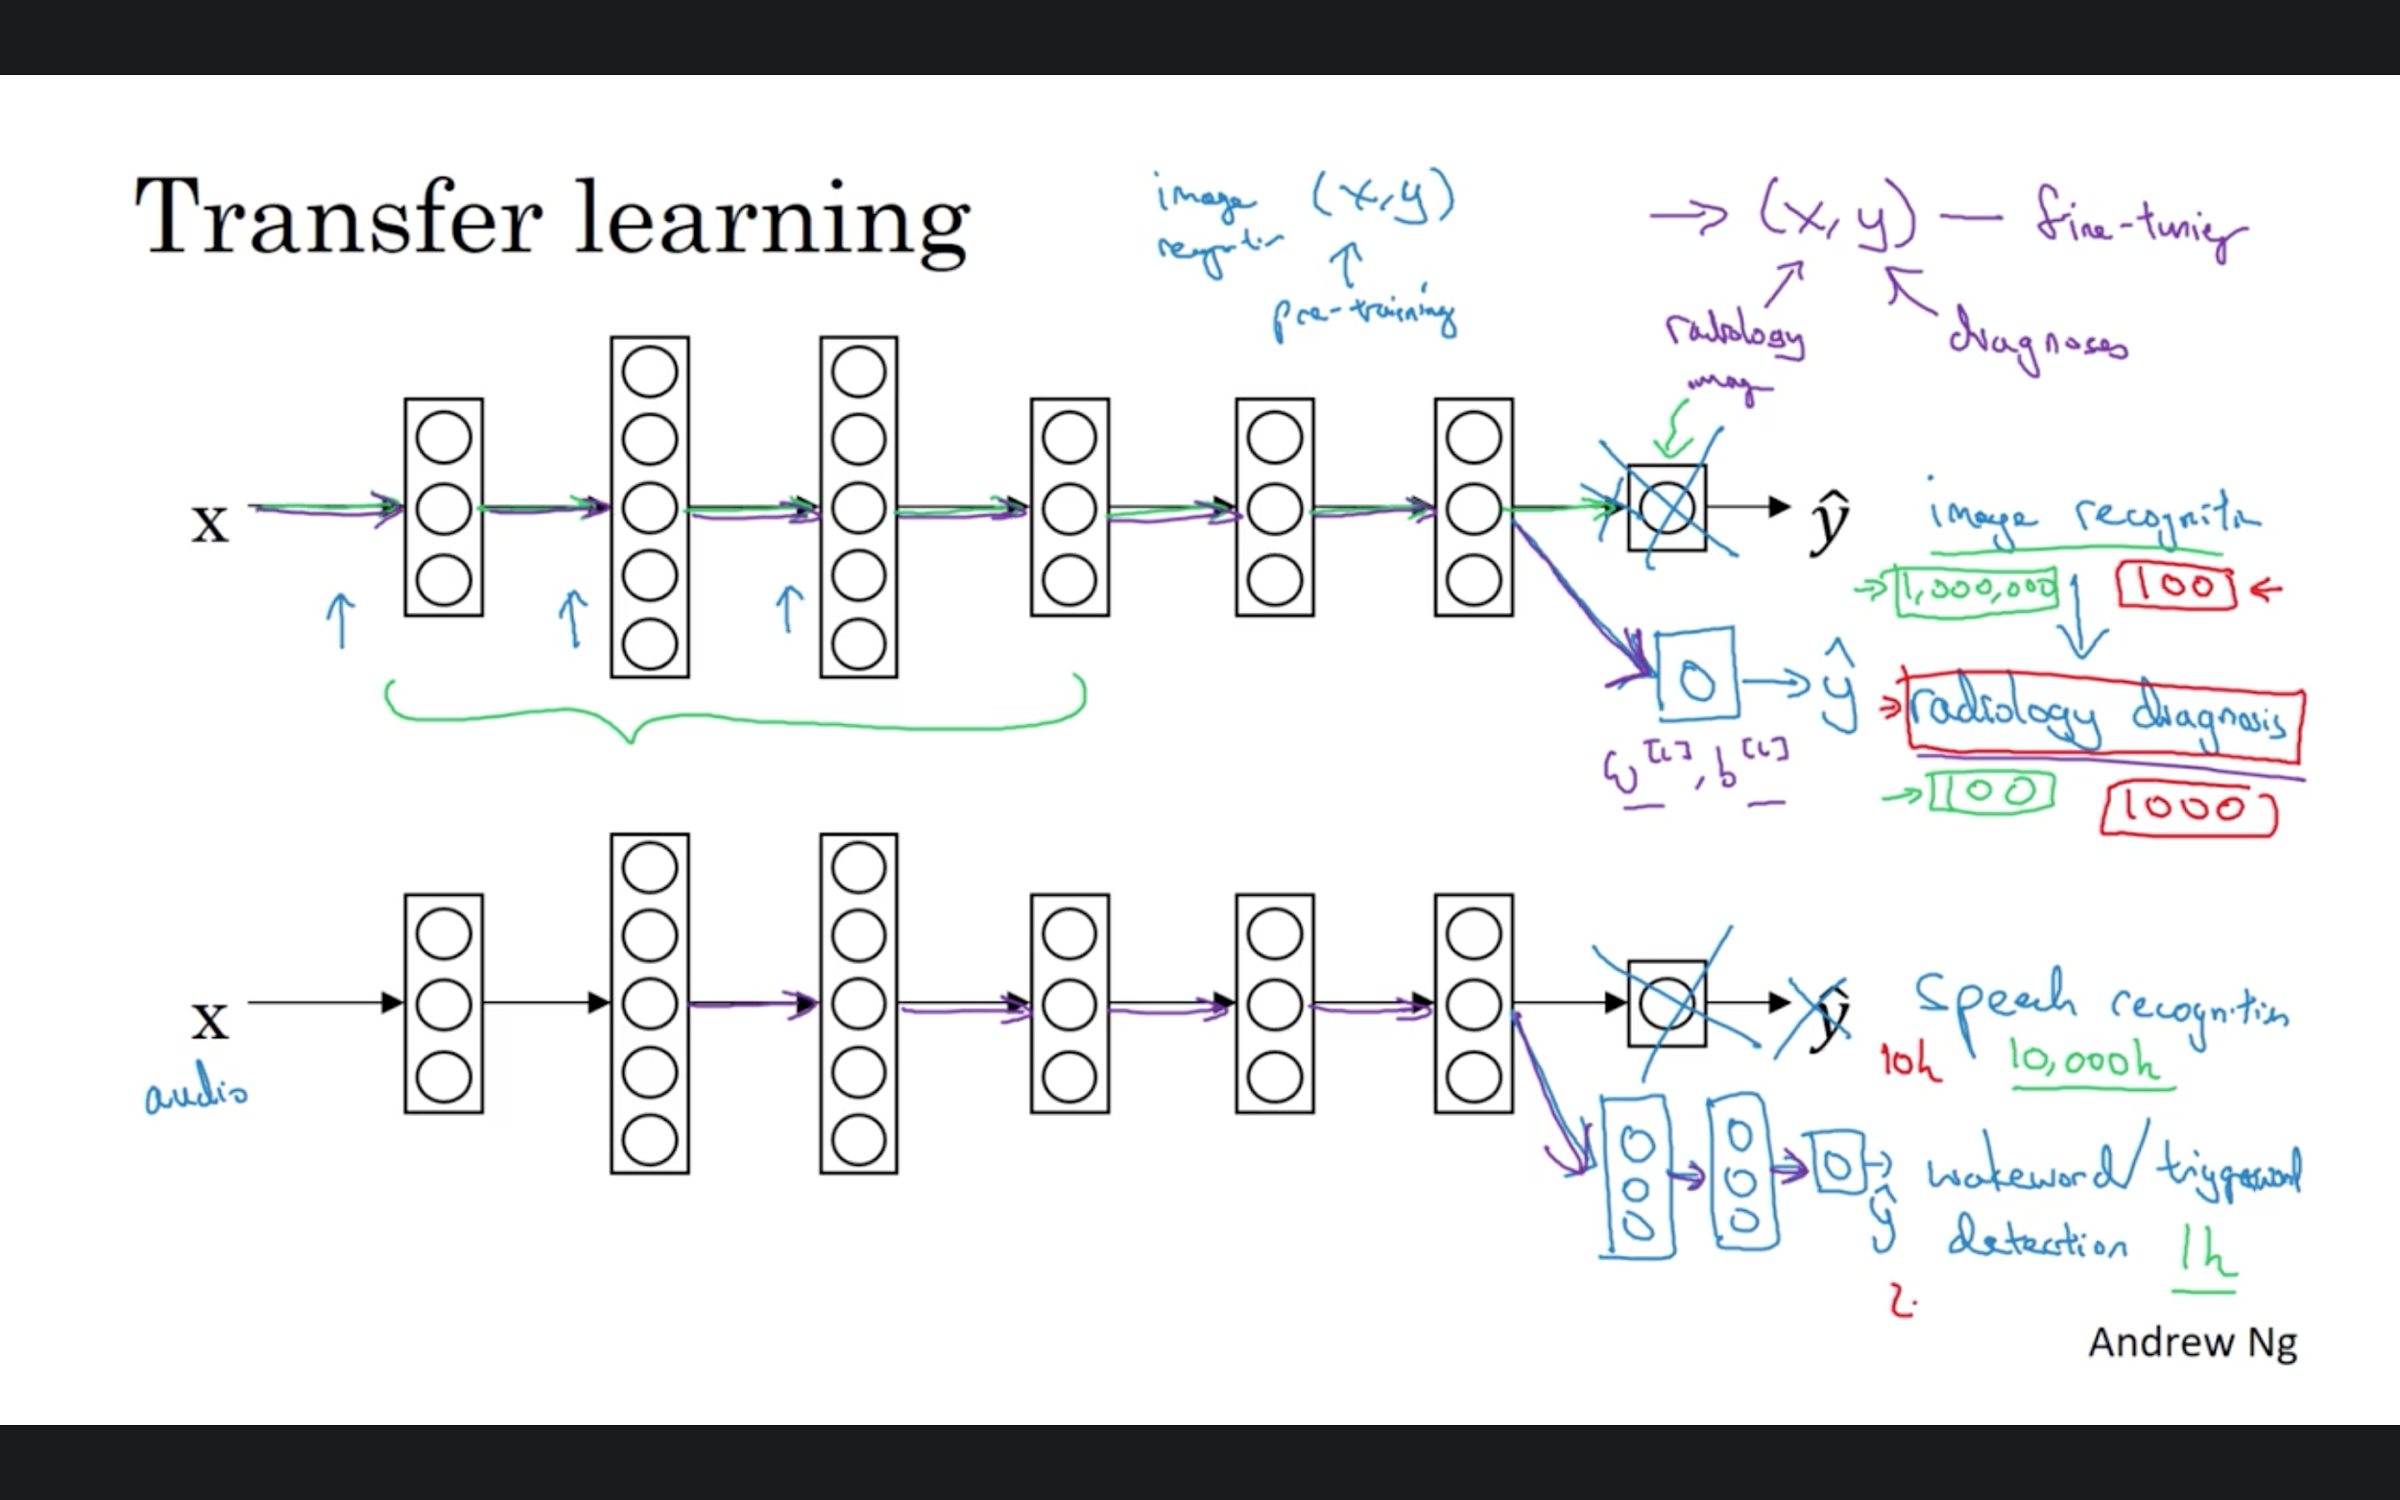
Notes:
The first phase analyzes all the images on disk and calculates the bottleneck values for each of them. 'Bottleneck' is an informal term we often use for the layer just before the final output layer that actually does the classification. This penultimate layer has been trained to output a set of values that's good enough for the classifier to use to distinguish between all the classes it's been asked to recognize. That means it has to be a meaningful and compact summary of the images, since it has to contain enough information for the classifier to make a good choice in a very small set of values. The reason our final layer retraining can work on new classes is that it turns out the kind of information needed to distinguish between all the 1,000 classes in ImageNet is often also useful to distinguish between new kinds of objects.
ConvNet as fixed feature extractor. Take a ConvNet pretrained on ImageNet, remove the last fully-connected layer (this layer’s outputs are the 1000 class scores for a different task like ImageNet), then treat the rest of the ConvNet as a fixed feature extractor for the new dataset. this would compute a 4096-D vector for every image that contains the activations of the hidden layer immediately before the classifier. We call these features CNN codes. It is important for performance that these codes are ReLUd (i.e. thresholded at zero) if they were also thresholded during the training of the ConvNet on ImageNet (as is usually the case). Once you extract the 4096-D codes for all images, train a linear classifier (e.g. Linear SVM or Softmax classifier) for the new dataset.

Slide 16

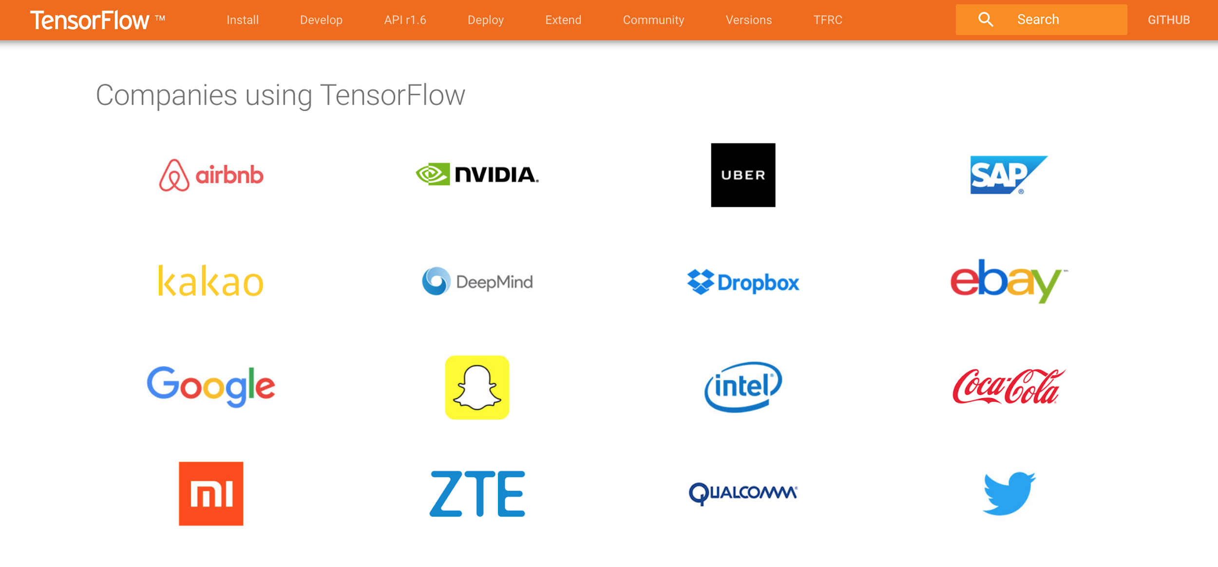
Notes:
TensorFlow is a tool for machine learning. While it contains a wide range of functionality, TensorFlow is mainly designed for deep neural network models. (speech recognition, image recognition) The most popular framework in deep learning.
You can run Tensor Flow on multiple platforms like Mac , Windows and Linux . TensorFlow support multiple GPU/CPU architecture .
Most people use python as a development language for tensorflow, well-supported,

Slide 17
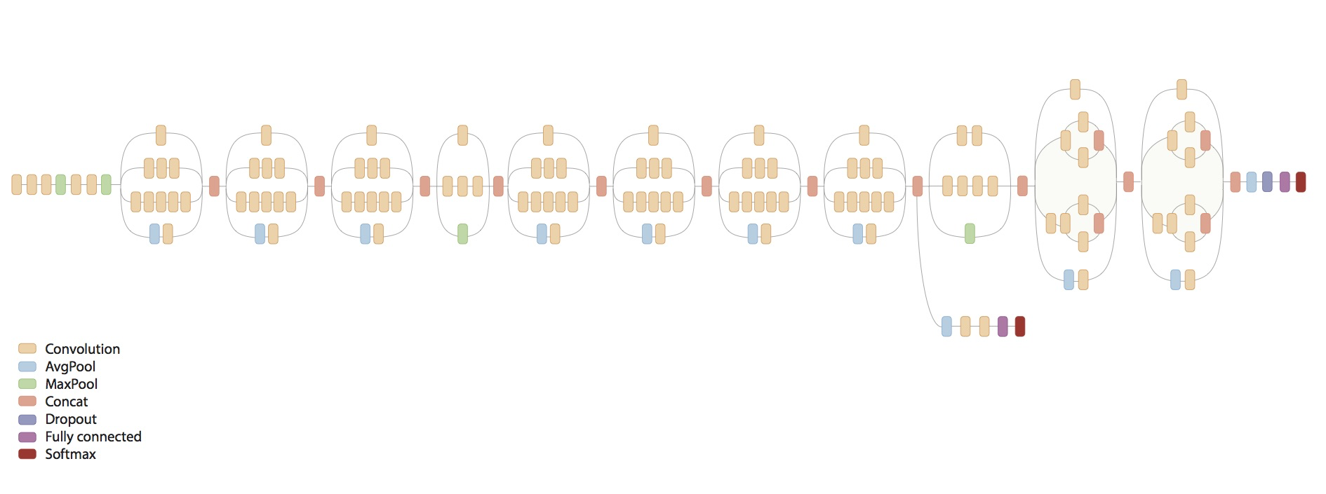
Inception v3
Notes:
Inception-v3 is trained for the ImageNet Large Visual Recognition Challenge using the data from 2012. This is a standard task in computer vision, where models try to classify entire images into 1000 classes, like "Zebra", "Dalmatian", and "Dishwasher". 1.2 M
Training an Inception v3 network from scratch across multiple GPUs and/or multiple machines using the ImageNet 2012 Challenge training data set.
Evaluating an Inception v3 network using the ImageNet 2012 Challenge validation data set.

Slide 18
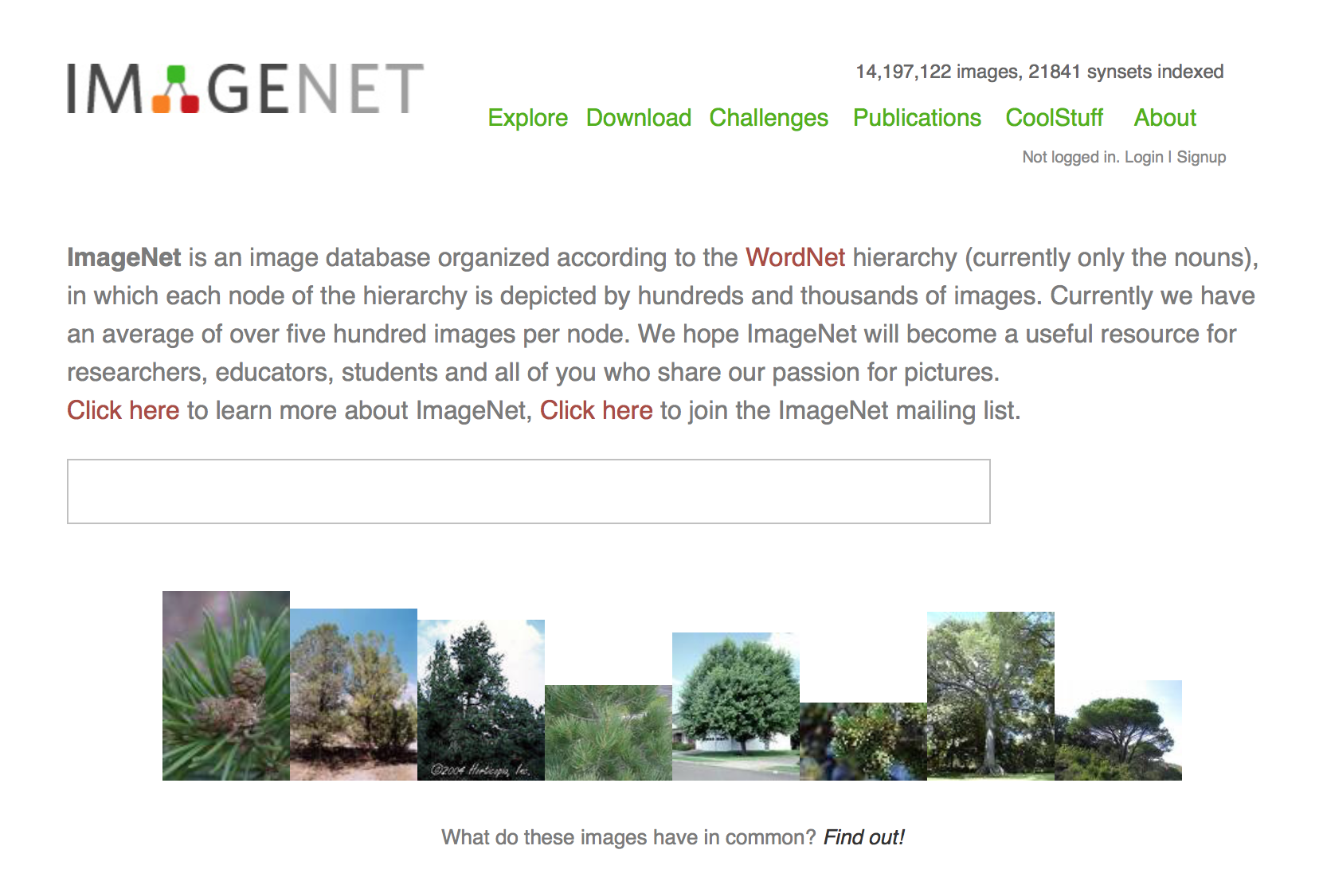
ImageNet
Notes:
IN is a visual database designed for use in visual object recognition software research. Over 14 million^{[1][2]} URLs of images have been hand-annotated by ImageNet to indicate what objects are pictured;

Slide 19
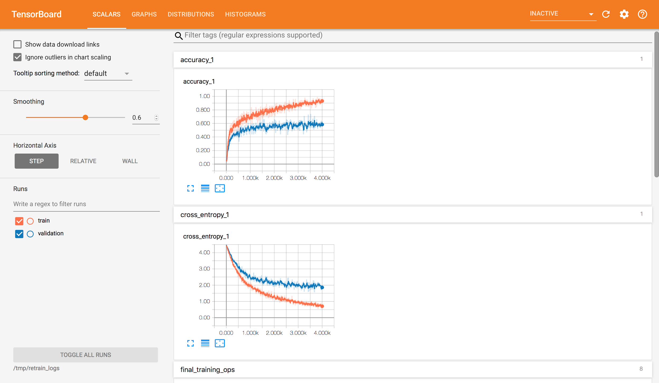
Model Evaluation
Notes:
−∑c=1Myo,clog(po,c)
−(ylog(p)+(1−y)log(1−p))

Slide 20
Model Evaluation
Data not clean (hand labeling)
More data (move to famous landmarks in the world)
Overfitting
U clusters)

Slide 21
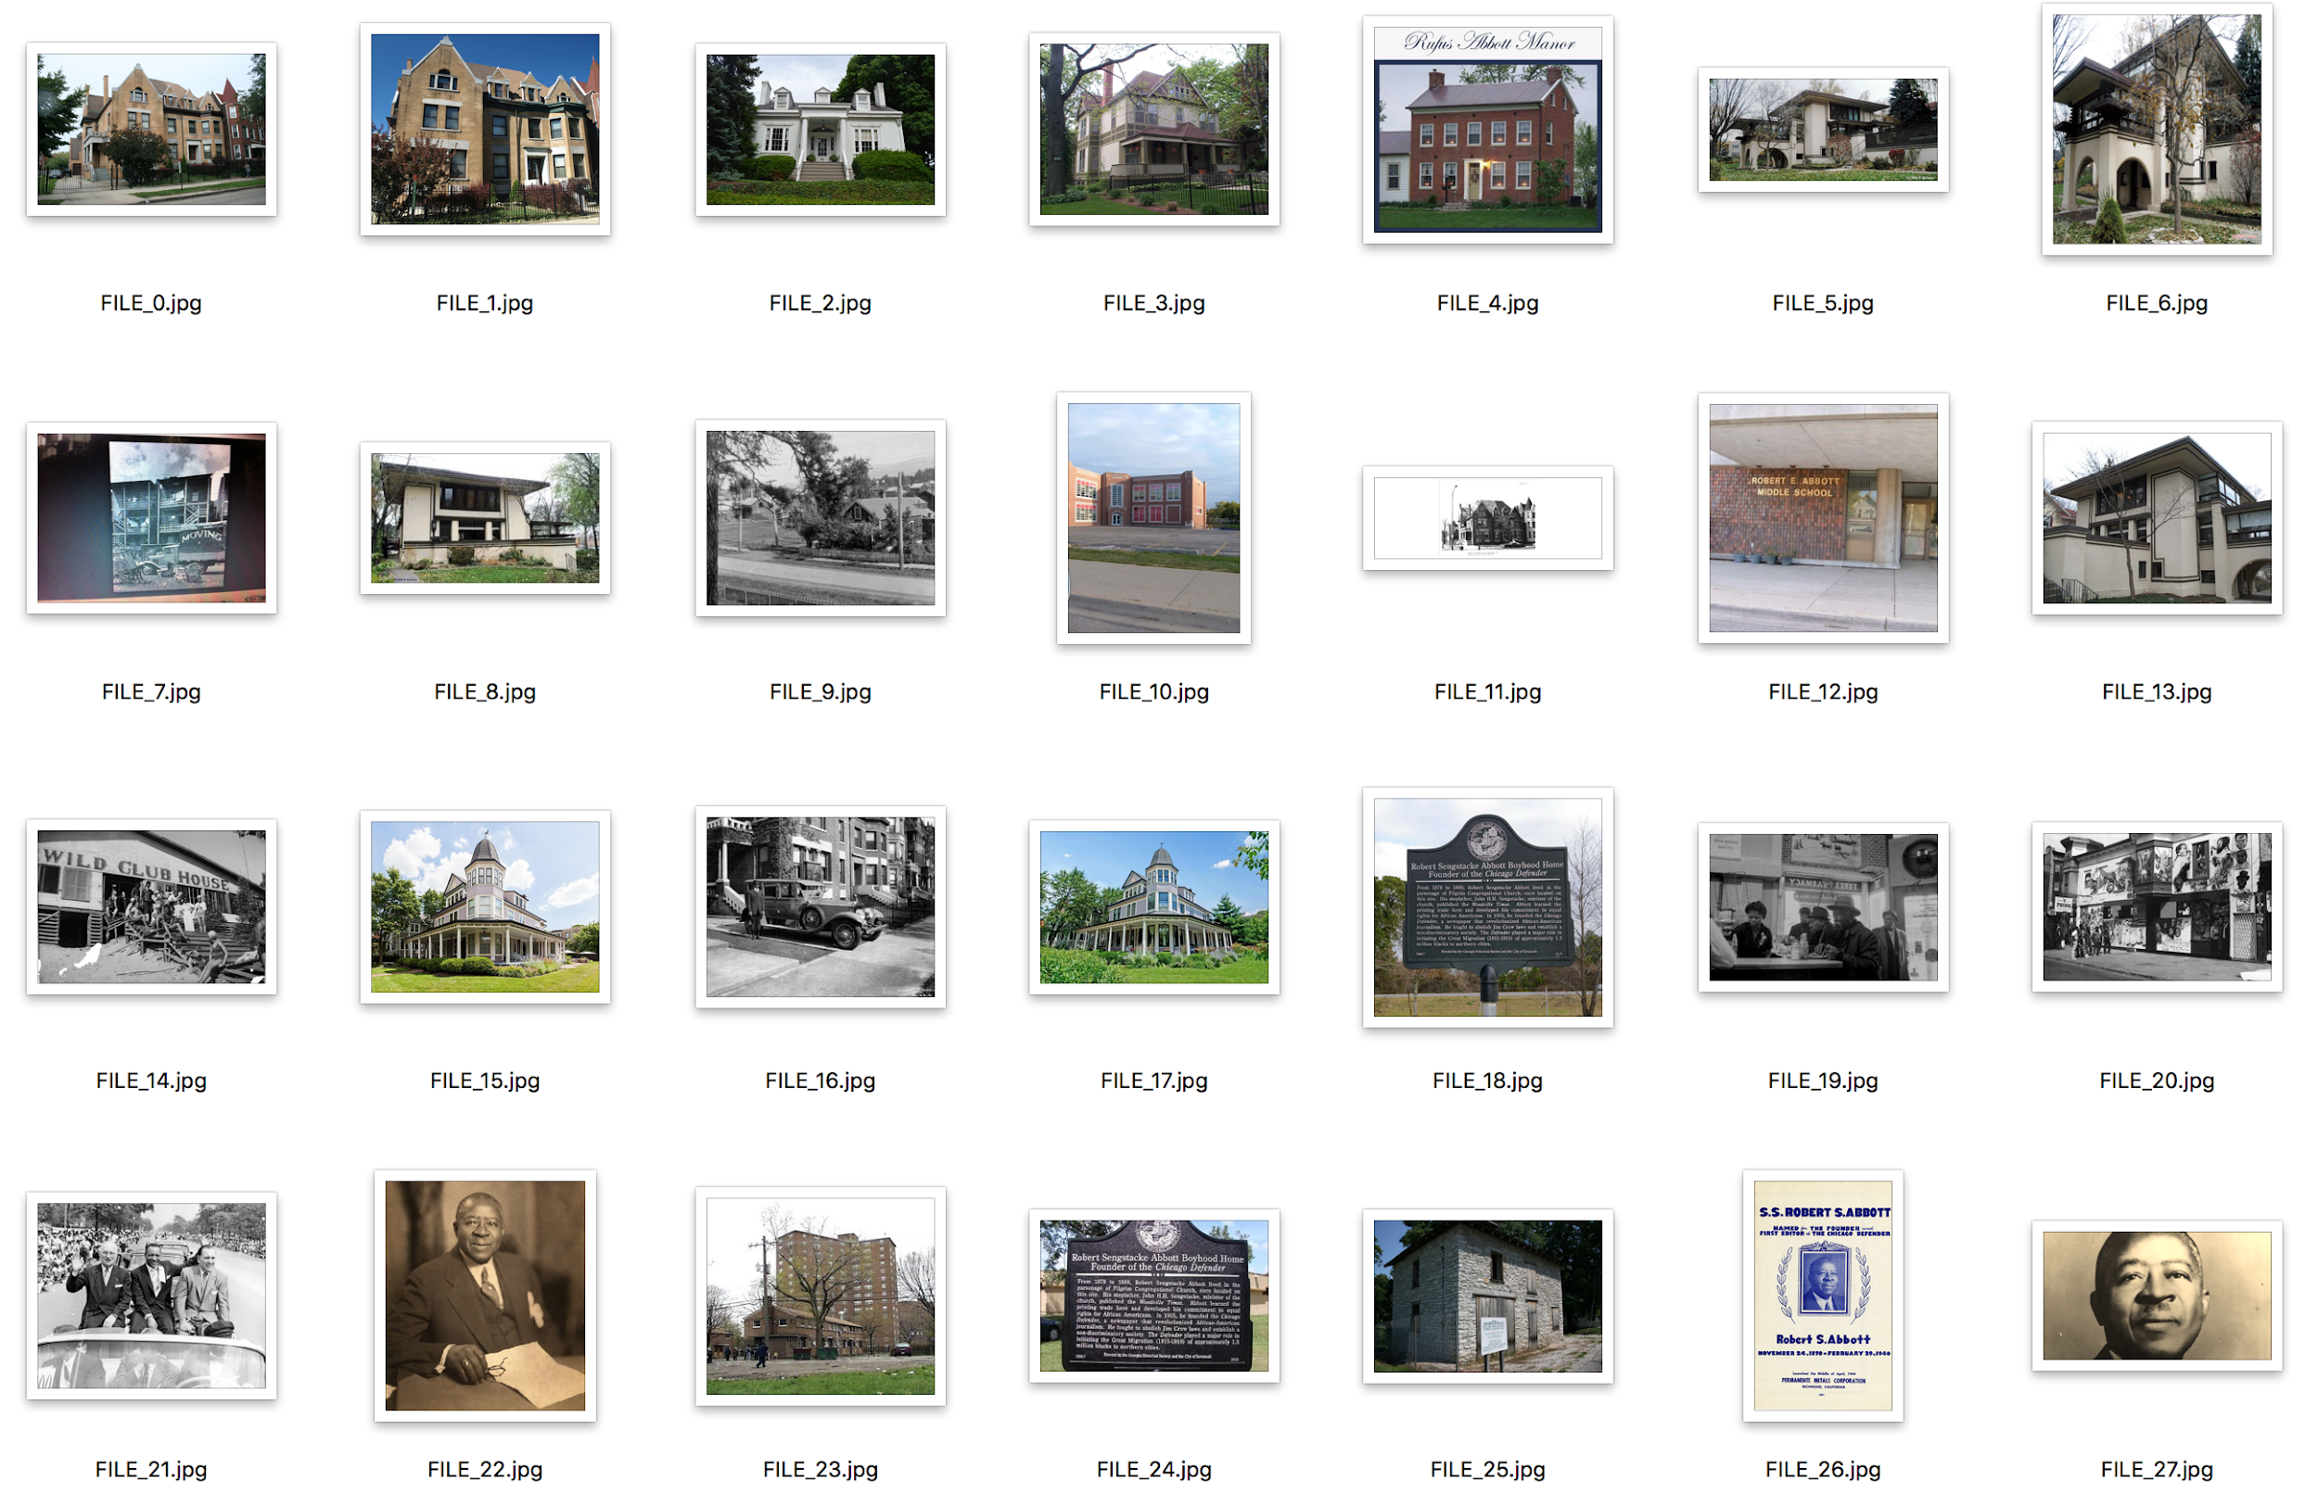
Model Evaluation
score: 0.24
Notes:
24%

Slide 22
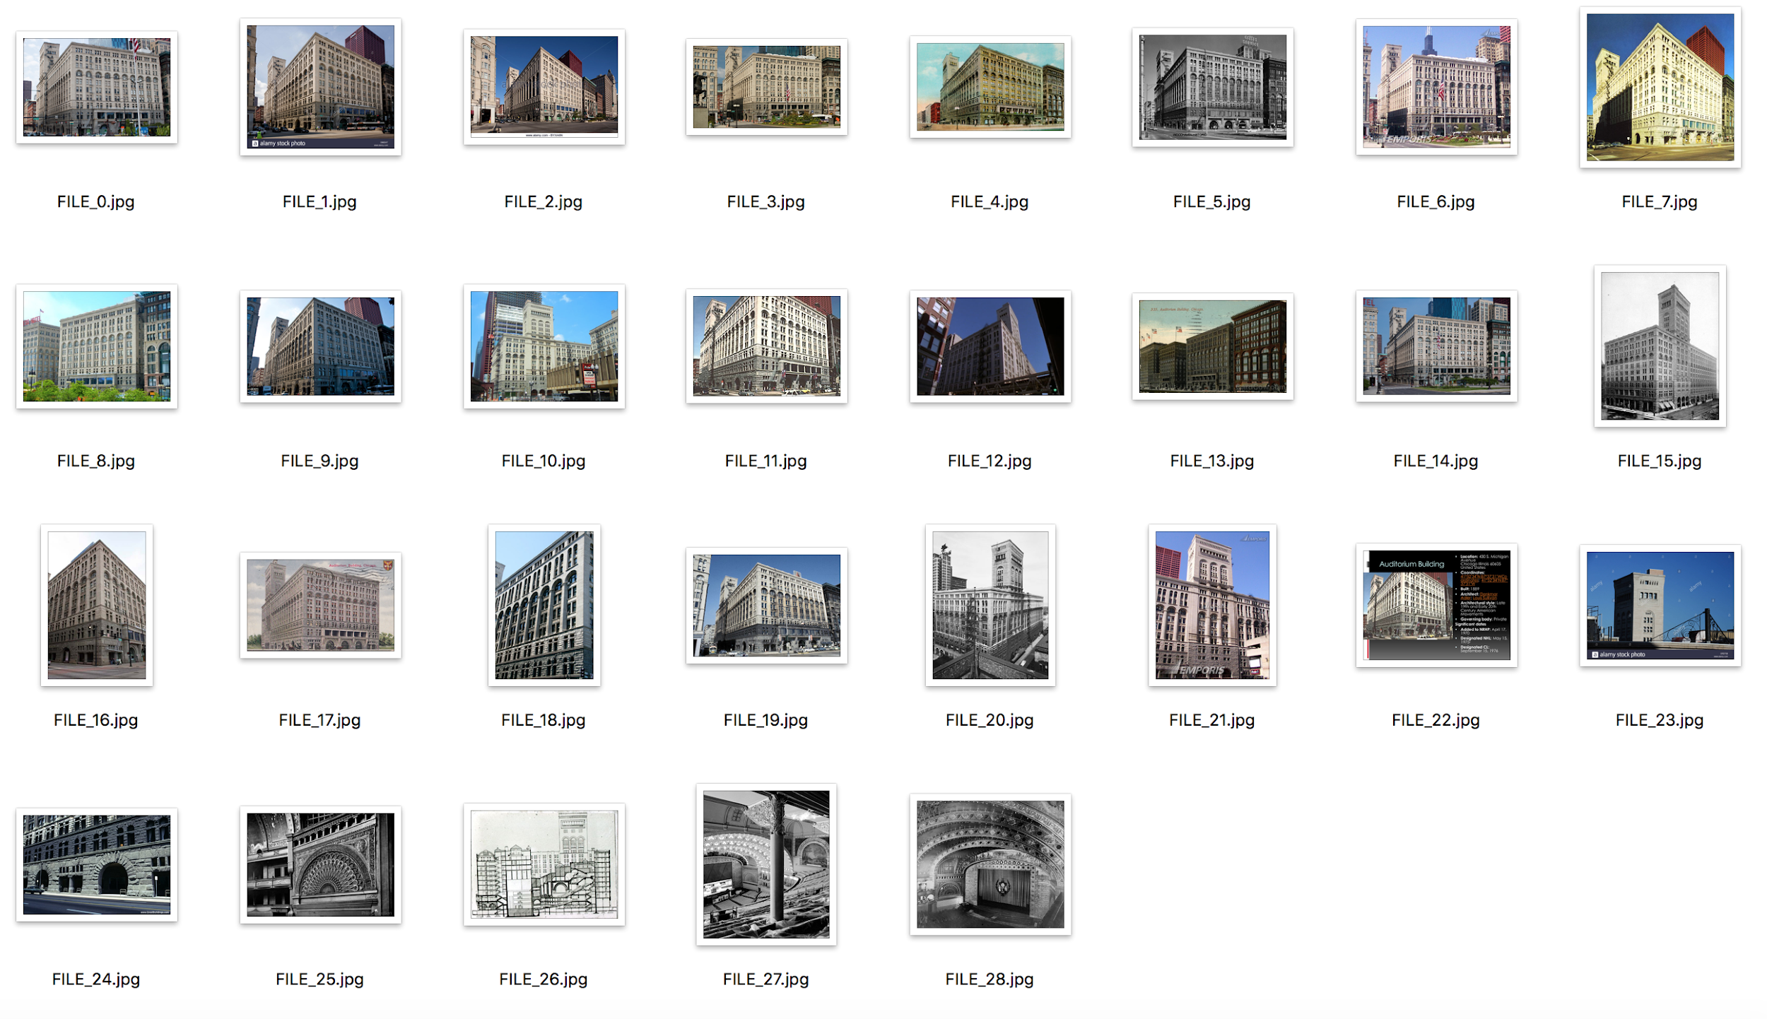
Model Evaluation
score: 0.73

Slide 23
Model Evaluation
Data not clean (hand labeling)
More data (move to famous landmarks in the world)
Overfitting
U clusters)

Slide 24
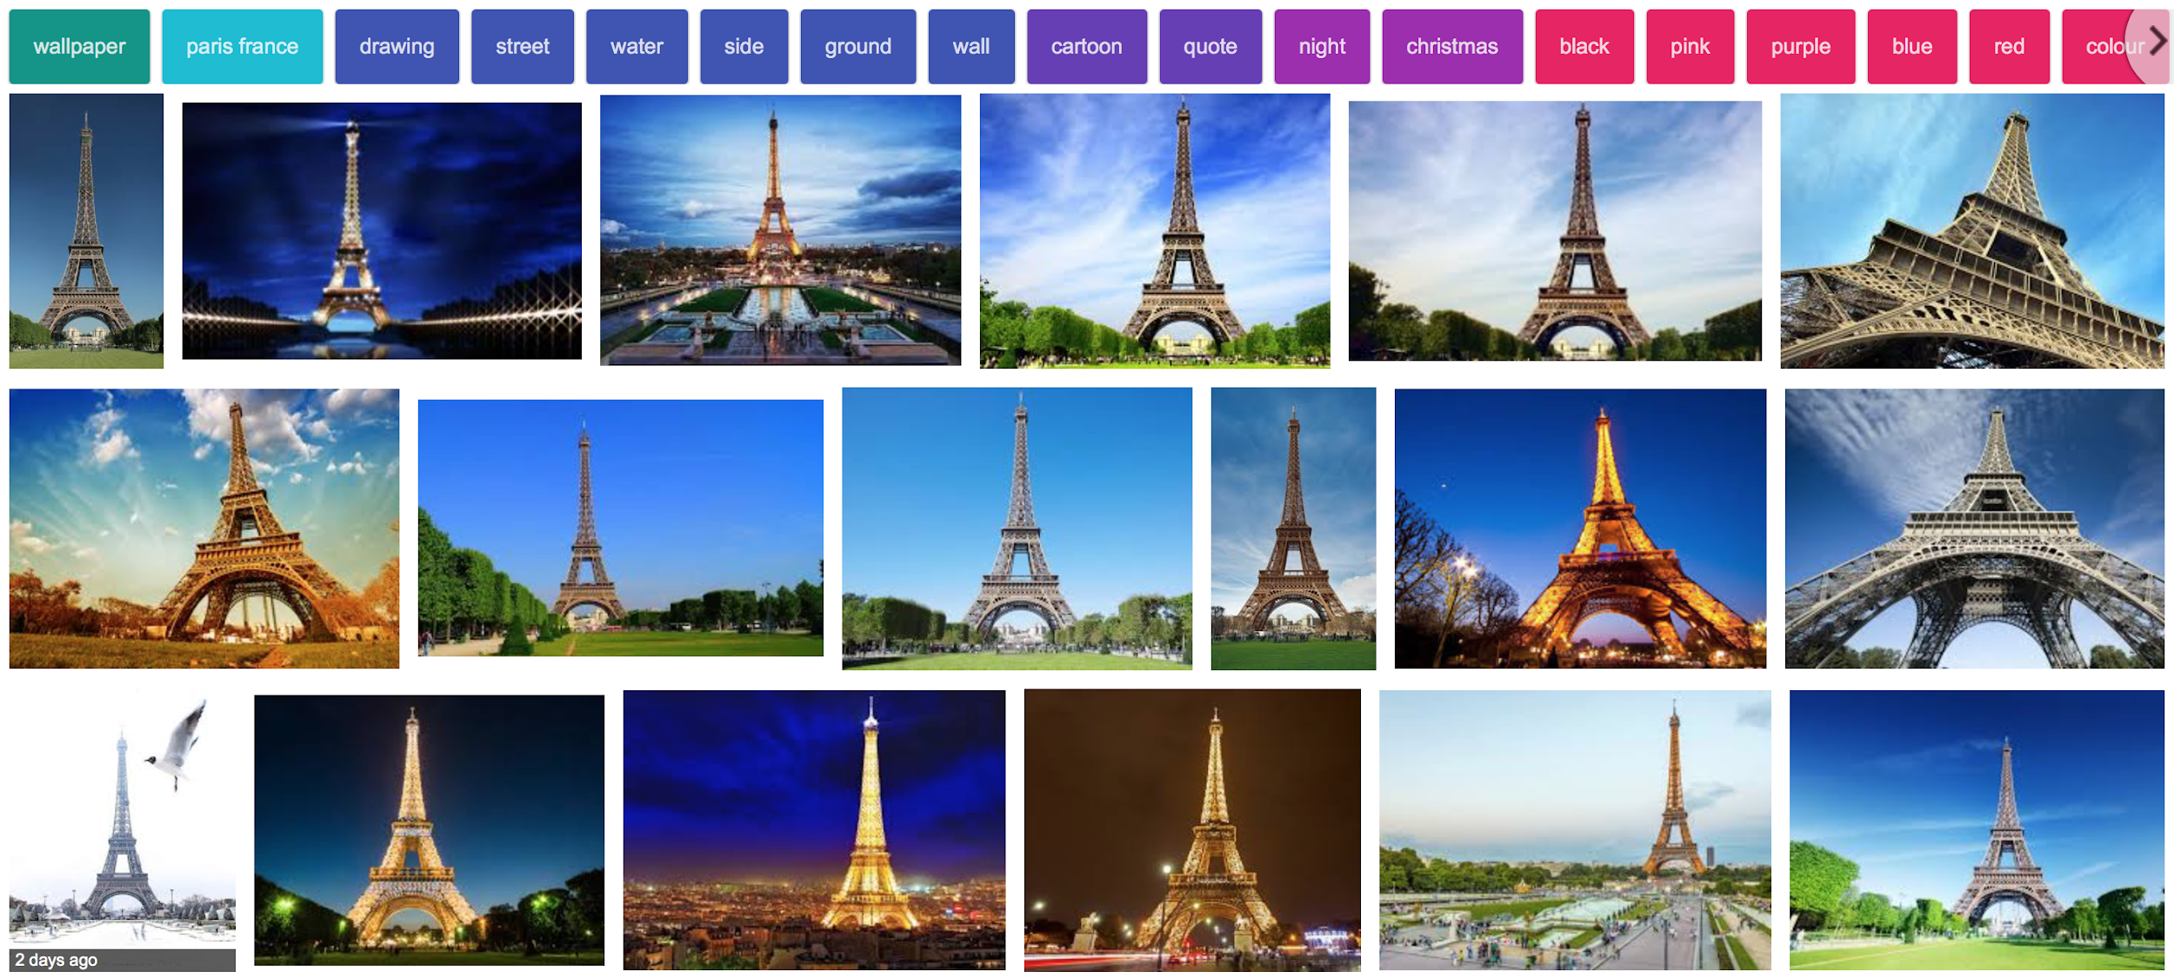
Model Evaluation

